Slide 1
Stage Tooling

Slide 2
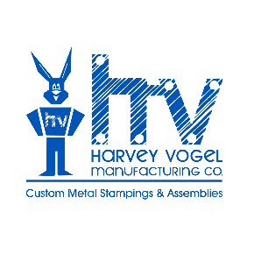
Our Specialty Since 1942!
Stage Tooling for Short to Medium Run Stamping:
2,000 to 50,000 pieces annually
Part Size: 0.5” x 0.5” to 24” x 36”
All Metals – Steel, Stainless, Aluminum, Red and Yellow Alloys
AS9100, ISO 901, ISO 14001, ITAR, Nadcap
Benefits Include:
Low tooling cost, lower part price
Available inventory of shared die sets reduce cost
Shorter lead times & quick turnaround for product to market
Rapid setup time with repeatable results for complex parts
Accommodates quick part revision economically

Slide 3
What is Stage Tooling?
This method uses one tool for each stamping operation including: blanking, forming, piercing, contouring, etc.
Shared common form die sets are used in production to lower the upfront cost.
Tooling is built in-house and maintained by HV for the life of the part.
Stage tooling offers low tooling costs and reduced part pricing from true fabrication method.

Slide 4
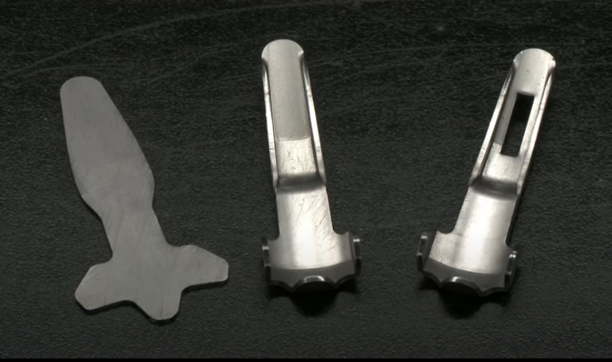
Stage Tool Production
Stage 1:
Blanked
Stage 3:
Pierced
Stage 2:
Formed
Click To Play Video
Example of a stamped part produced using separate Stage Tools.
Typical stages include:
Blanking
Forming
Piercing
Contours

Slide 5
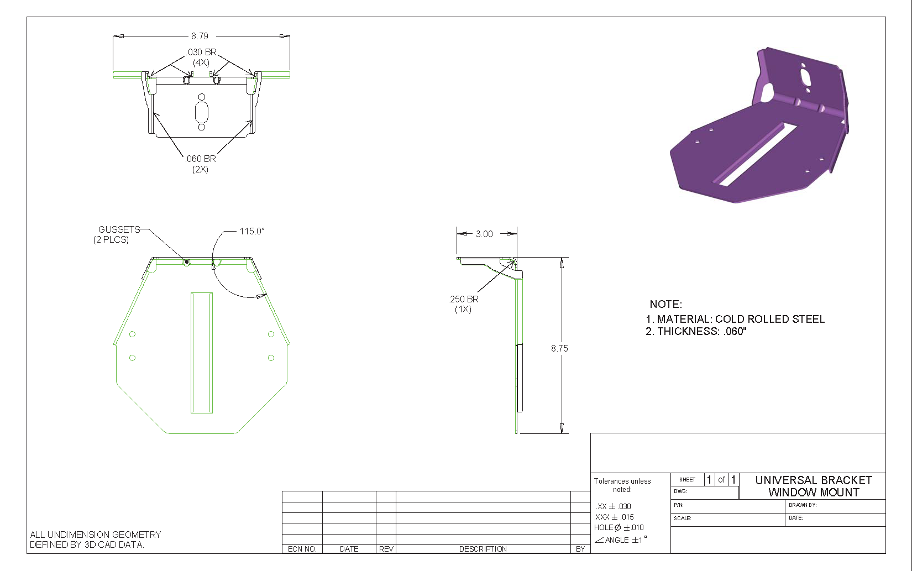
Case Study – Window Mount Bracket

Slide 6
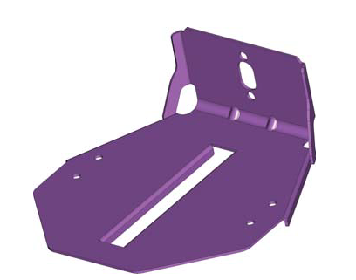
Case Study – Process Comparison
Soft Tool Fabrication
1) Laser
2) Detab
3) Sand
4) Press brake hit 1 ▪ Set up ▪ Run – 4 hits
5) Press brake hit 2 ▪ Set up ▪ Run – 2 hits
6) Press brake hit 3 ▪ Set up ▪ Run – 1 hit
Stage Tool Stamping
1) Compound blank die ▪ Set up ▪ Run – 1 hit
2) Wipe form die ▪ Set up ▪ Run – 1 hit
3) Contour form die ▪ Set up ▪ Run – 1 hit
4) V-form die ▪ Set up ▪ Run – 1 hit
Progressive Die Stamping
1) Progressive die ▪ Set up ▪ Run – 1 hit

Slide 7
Case Study – Total Cost Analysis
Stage Tool Break Even: ~2,750 pcs
Progressive Die Break Even: ~21,000 pcs

Slide 8
Case Study – Total Cost Analysis
Stage Tool Break Even: ~2,750 pcs
Progressive Die Break Even: ~21,000 pcs

Slide 9
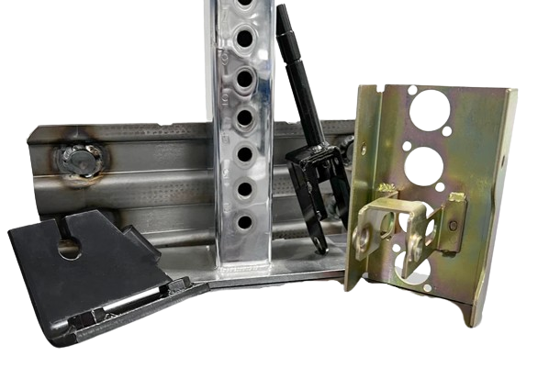
Stage Tooling Summary
Short-run metal stamping offers a rapid setup time, minimal tooling investment, and repeatability for complex high-quality parts.
2,000 – 50,000 pieces annually, most efficient process for low to medium volumes
Low upfront cost: $1,000s per tool
Lower piece price
In-house shared die sets reduce cost
Shorter tooling lead times
Quick turnaround for product to market (ROI)
Design freedom:
Materials
Easier to modify
Complex geometries
Tight tolerances

Slide 10
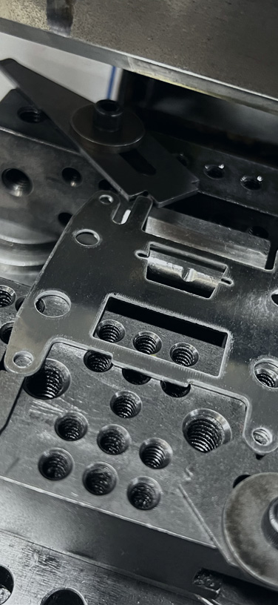
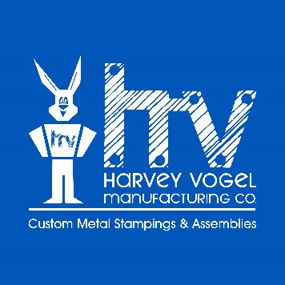
Resource Links:
ISO 9001, AS9100 and ISO 14001 Certifications
Company Brochure
HV Team Directory
Sales Representative Directory
Customer TOC
Harvey Vogel Manufacturing Co.
sales@harveyvogel.com
harveyvogel.com
P: 651-739-7373

